Slide 1



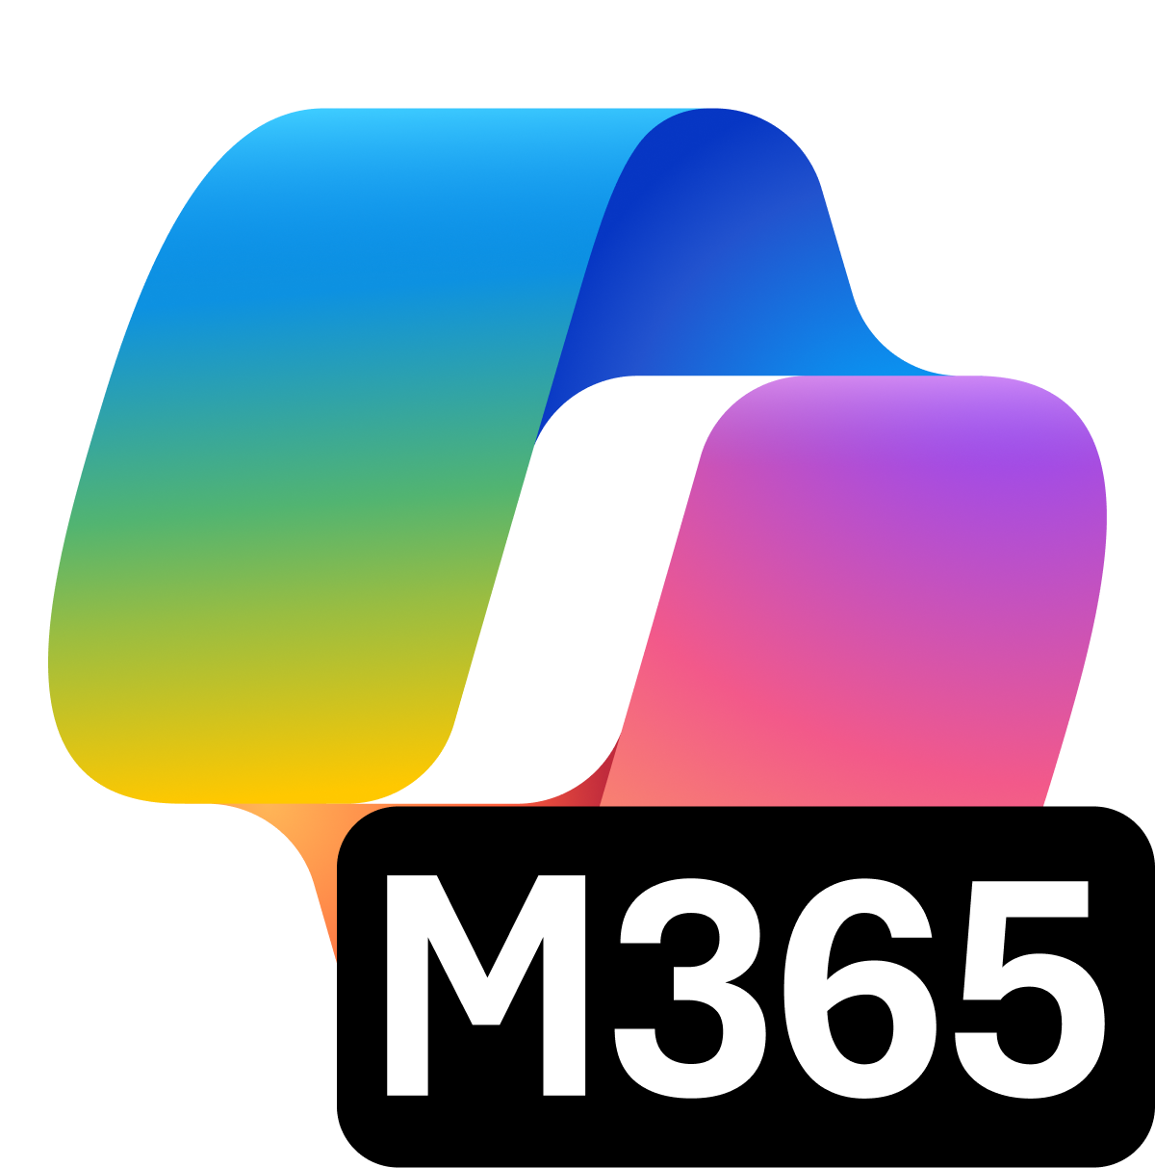


Microsoft Purview Suite for Microsoft 365 Business Premium
Intelligent compliance and risk management in the age of AI
AI transformation is happening now.
Secure and govern your data estate and get ready for AI
Microsoft Purview Suite, now available as an add-on to Microsoft 365 Business Premium, providers integrated data security and compliance capabilities critical for organizations looking to adopt Gen AI technologies and minimize risks related to regulatory requirements.
Safeguard sensitive data across clouds, apps, and endpoints.
Identify and remediate critical risks within your organization.
Investigate and respond to legal requirements with relevant data.
Built-in assessments and actions for 350+ regional regulations
Unified solutions to secure and govern data for the era of AI
Address oversharing concerns
Protect against data loss and insider risks
Govern AI use to meet regulations & policies
Gain visibility into overshared content.
Remediate excessive permissions.
Prevent Generative AI from processing sensitive files.
Get alerts and reports of risky behavior and AI use.
Protect sensitive files and Copilot interactions.
Dynamically apply security policies based on risky actions.
Inspect interaction content and audit logs.
Investigate for compliance and ethical violations.
Enforce lifecycle policies and legal holds.

Slide 2



Incremental security capabilities from Business Premium to Purview Suite
Business Premium
Purview Suite
Identity and access management: Conditional Access based on predefined conditions like device compliance, location, and app sensitivity
Purview Information Protection: Encrypt emails and discover, classify, and manually label sensitive data.
Endpoint management: Manage devices and work data on company-owned and employee devices. Remove business data from lost or stolen devices
eDiscovery & Audit: Empowers legal and compliance teams with integrated tools and deep visibility to streamline investigations, enforce legal holds, and maintain regulatory readiness Insider Risk Management: Helps detect and mitigate internal threats with privacy-respecting behavioral analytics and granular communication controls Information Protection & Governance: Enables organizations to classify, protect, and manage sensitive data across its lifecycle, ensuring secure collaboration and compliance at scale
Save up to 47% per license with the Purview Suite for Business Premium
Microsoft Purview
Standalone bundles​
Per user, per month
Microsoft Purview Suite for Business Premium​
Information Protection +Governance | $7
Data Loss Prevention Information Protection Data Lifecycle Management …and more​
Insider Risk Mgmt. | $6
Insider Risk Management Communication Compliance Privileged Access Mgmt …and more​
eDiscovery + Audit | $6
eDiscovery (Premium) Audit (Premium)​​
>$19.00
$10
Save ~47% per license​
Enable end-to-end data security + compliance​
Prepare for GenAI +regulatory requirements
value of individual licenses
Microsoft Purview Suite for Business Premium

Slide 3
Upgrade investment snapshot to add Purview Suite to Business Premium
Current SKU | {start_sku}​
# Seats | {seats}​
Current investment​ | {expiring_arr}
Upgrade solution​ | {target_sku}
# Proposed seats for upgrade​ | {add_proposed_seat}
Actual cost of the solution per user | {actual_price_per_user}
Incremental cost per user​ | {incremental_cost_per_user}​
Total incremental annual investment for {seats} seats | {overall_incremental_cost}
[NOTE - PLEASE DELETE BEFORE SENDING TO THE CUSTOMER]
The calculation above is based on active promos, partner MAICPP status, Microsoft Commercial Incentives, and Microsoft list price, and assumes additional information on margins. This is for reference only and subject to change. Please review the calculation, and adjust before sending it to the customer. Microsoft would not be responsible for the content or accuracy of any information/claim made in this document, or for any decisions made based on such information.

Slide 4
Enhance your security posture with [PARTNER NAME]
[INSTRUCTION FOR THE PARTNER] Partner to insert their personalized information on: Value proposition and methodology, experience, Microsoft services, advanced specializations, and past awards.
You can leverage Copilot Chat to customize this section! Add your website URL, upload this flyer on Copilot Chat, and prompt it to write a draft for this section.

